Slide 1

PowerShell Task 2 Defend
PRESENTING:
Implement safeguard CIS 9.2 Use DNS Filtering Services to block malicious domains
Enable the Windows 11 Firewall to block HTTP traffic
Tim Ho
Student ID: 12241028 https://github.com/TimPortFoliHo/ePortfolio.git

Slide 2
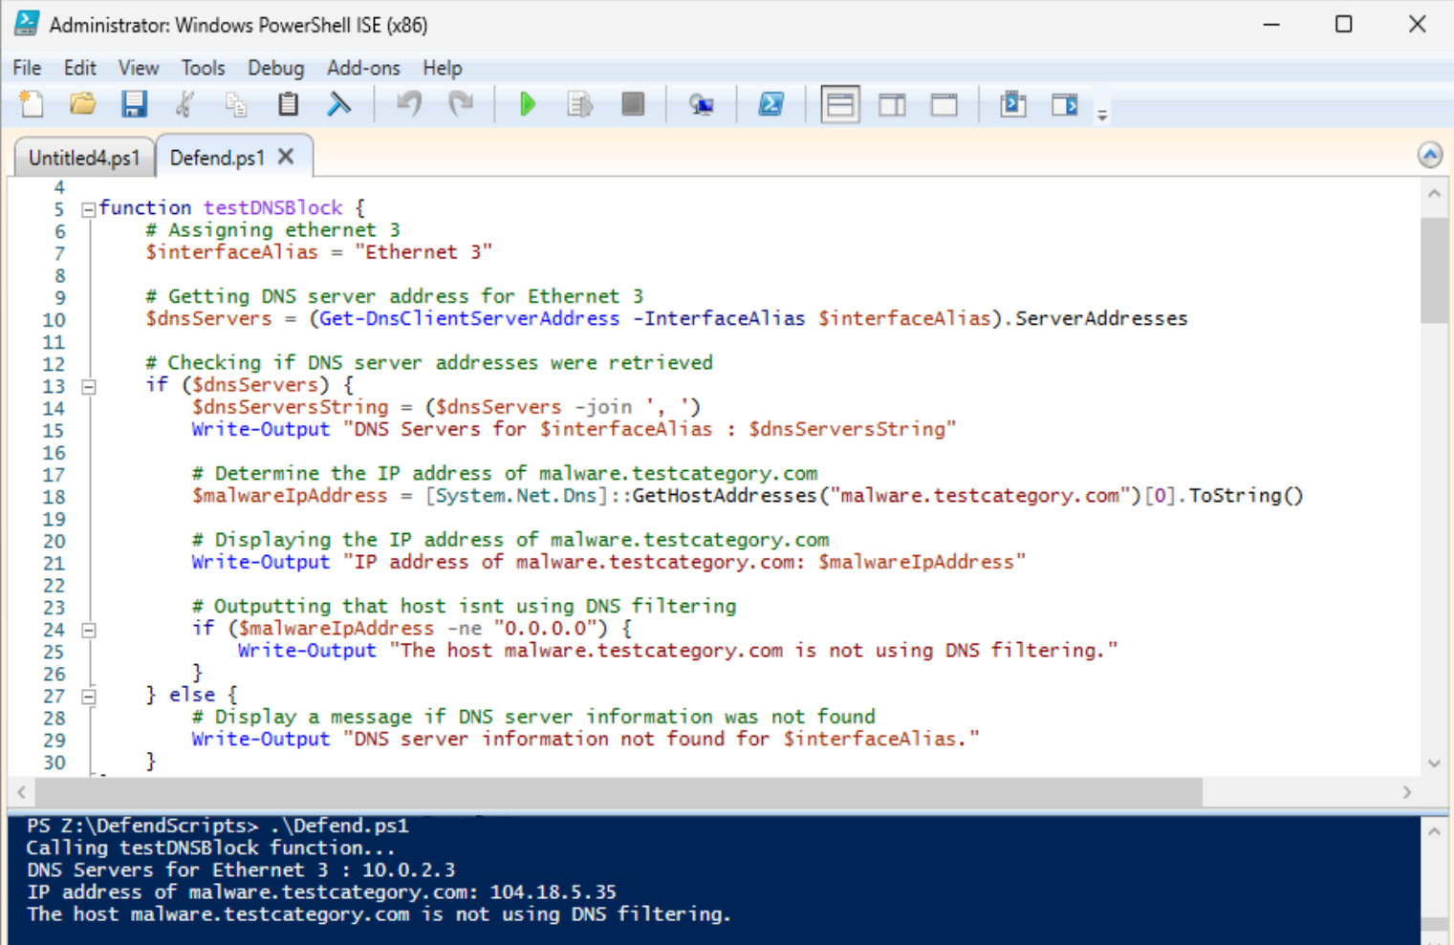
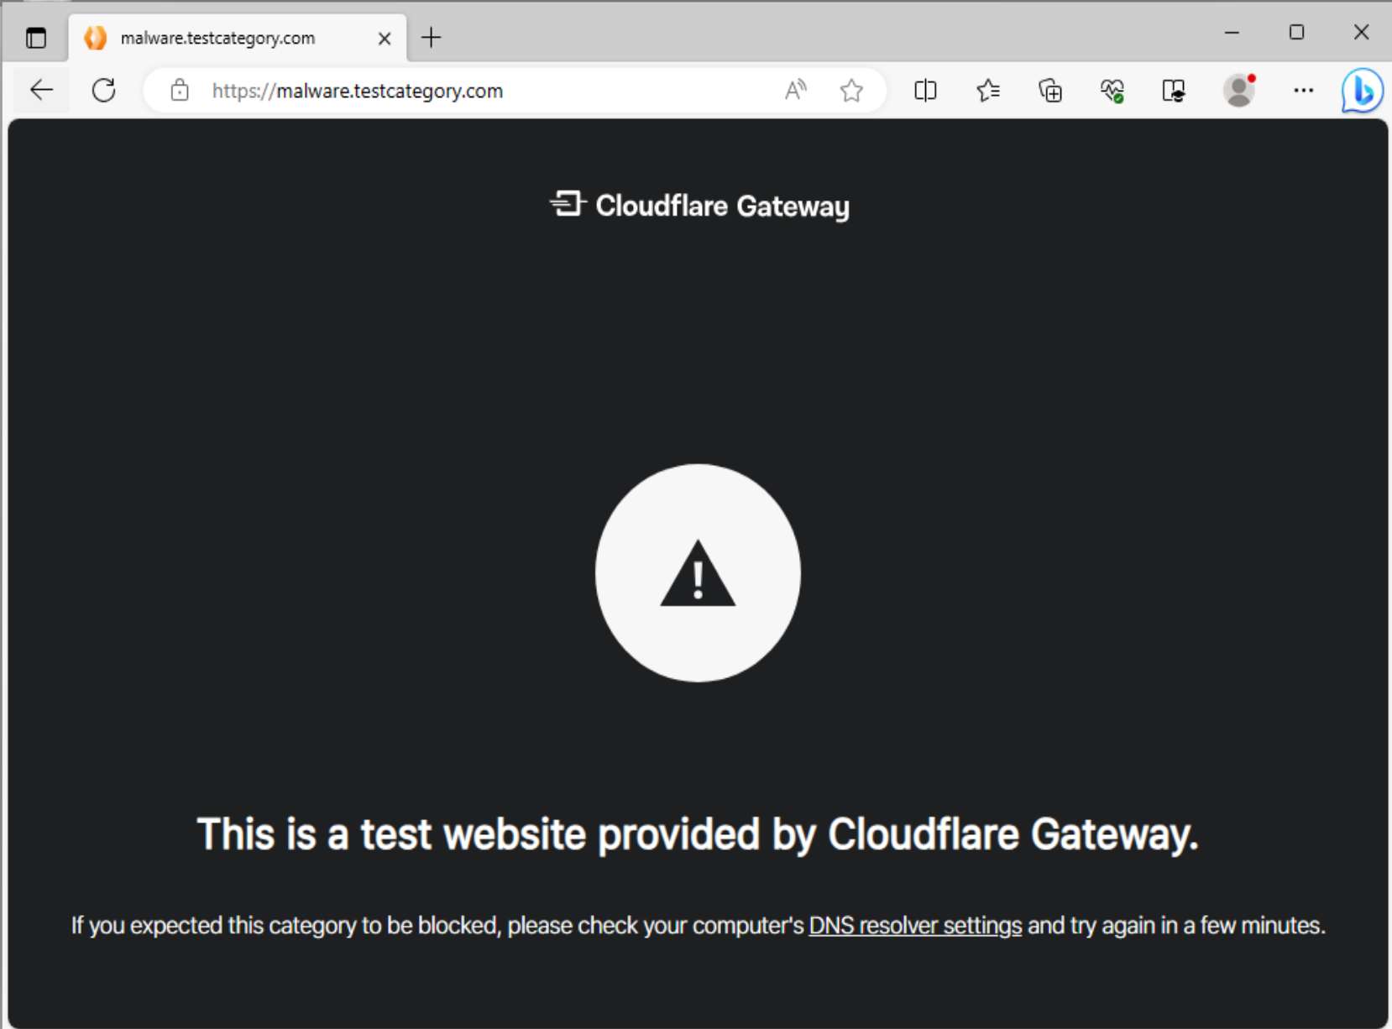
testDNSBlock(): Script file path to shared file on VM ‘Z:\DefendScripts’ Output: 1.DNS server of ethernet 3 NIC 2.Ip address of malware.Testcategory.Com 3.A statement whether the host IP address is using DNS filtering

Slide 3
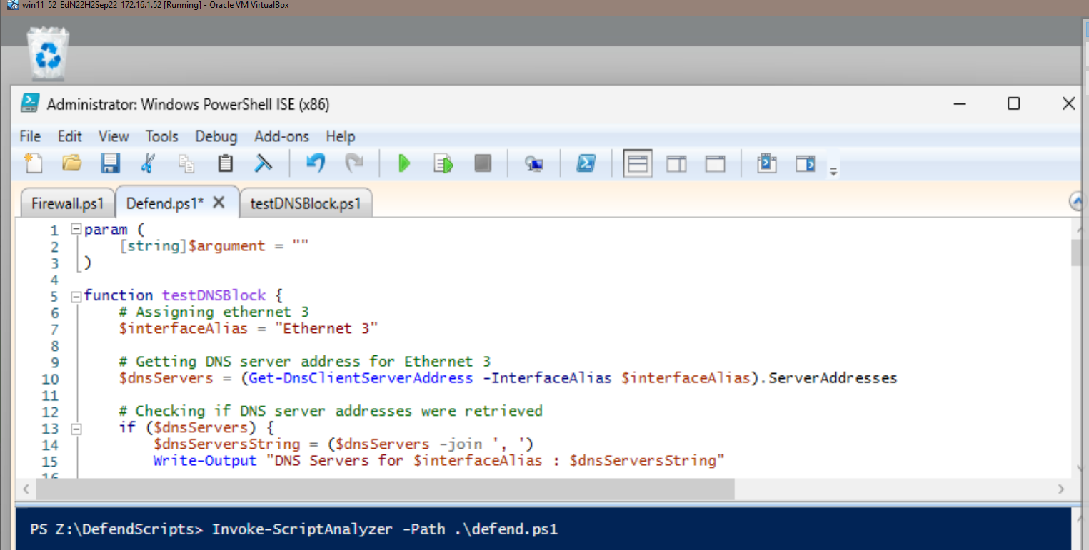
PSScriptanalyzer: Image showing that ‘invoke-scriptanalyzer’ was used to clean up code. As nothing was outputted in terminal, code is considered clean to psscriptanalyzer standard.

Slide 4
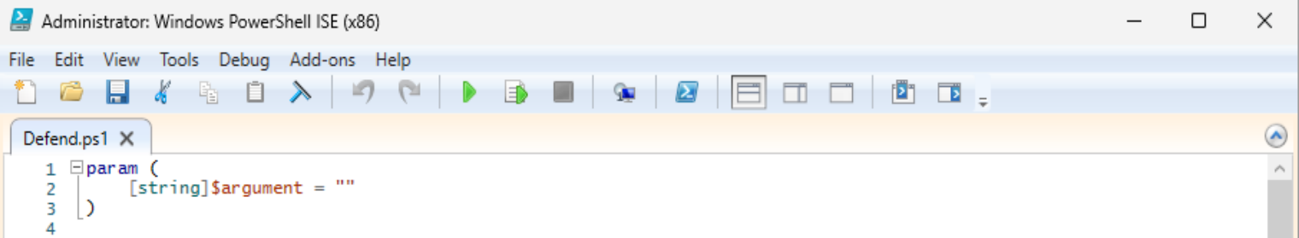
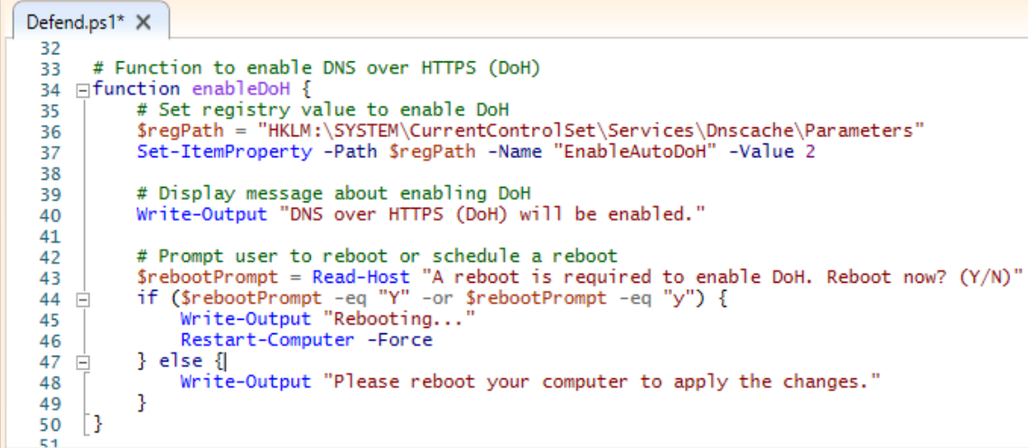

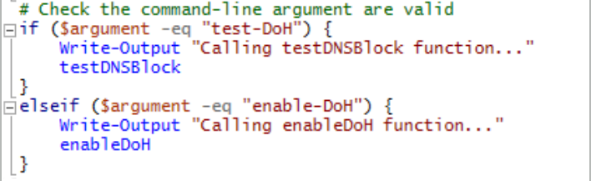
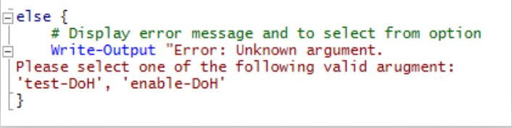
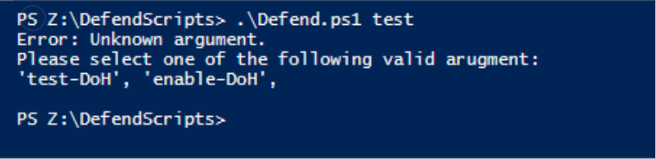
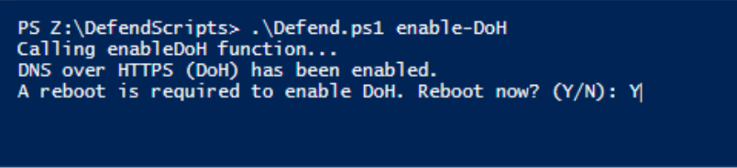
ENABLE DNS over HTTPS: -enableDOH function prompts user to reboot to enable DoH when user enters ‘Y’ into the command line Once user - if user enters ‘N’ a message will appear for user to reboot for DoH to be enabled. Checking valid arguments: - Lines 1-4 turns functions into arguments that can be called - Bottom segment will return message that states valid options to choose from if user doesn’t input valid option

Slide 5
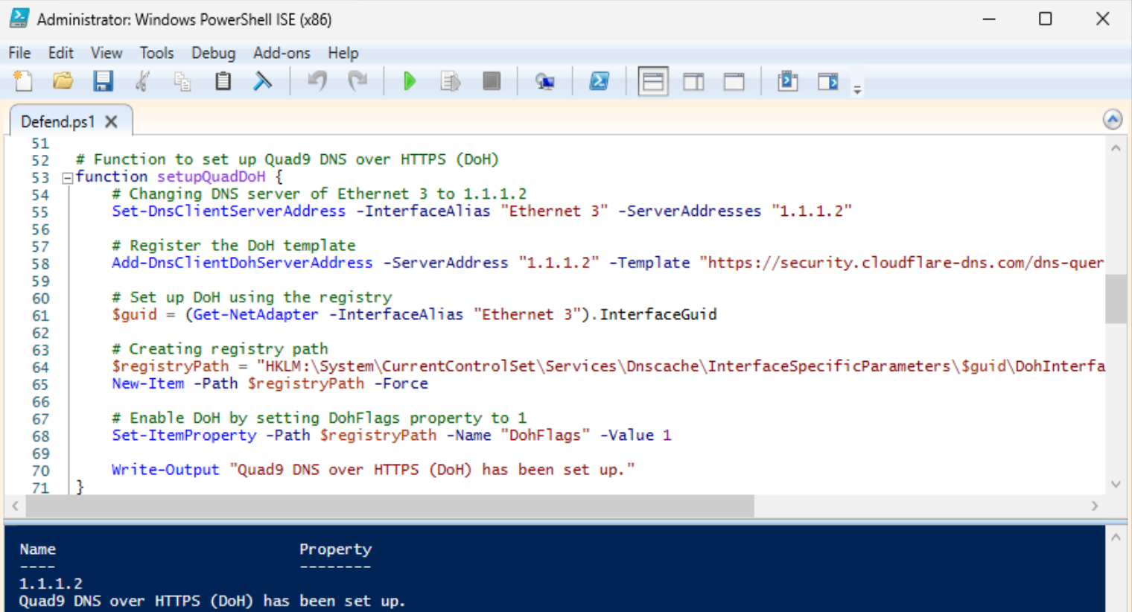
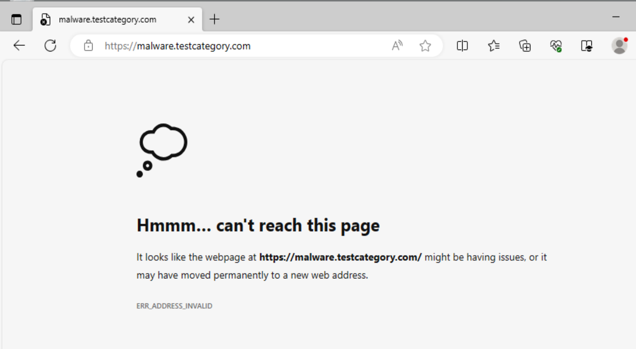
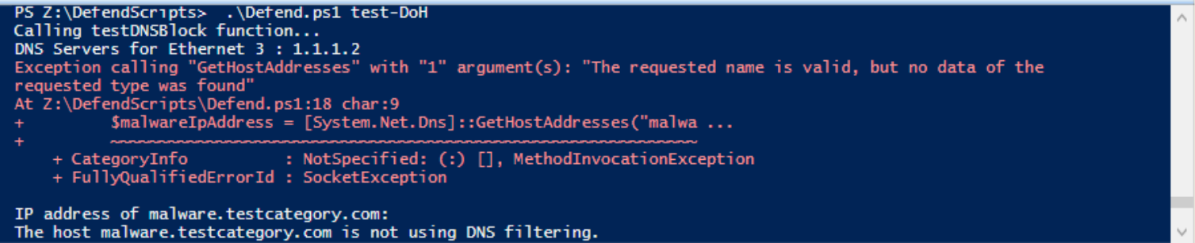
setupQuadDOH(): This function helps encrypt the DNS queries from the computer through checking the domains that are registered as malicious on Cloudflare's DNS server 1.1.1.2 The DoH will block access to those website as seen when trying to access malware.testcatergory.com when the function is enabled
Post test: rerun of testDNSBlock() function:

Slide 6
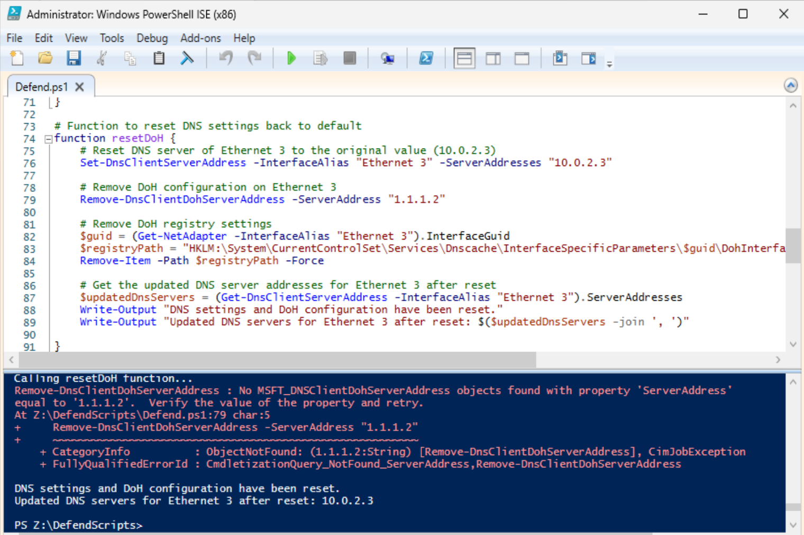
RESETDOH(): -ResetDoH function will rest the DNS setting and DoH configuration and will output the message to show that - if user tries to visit the malware.testcategory.com domain again, they will have access to it, showing that the settings have been reset

